Slide 1
Sprint 9
Team 9

Slide 2
What We Did
01
02
03
04
Jeopardy
Maze Game
Added jeopardy winning logic
Designed and implemented maze game
About Us
Styling
Updated about us to include global theme
General styling changes

Slide 3
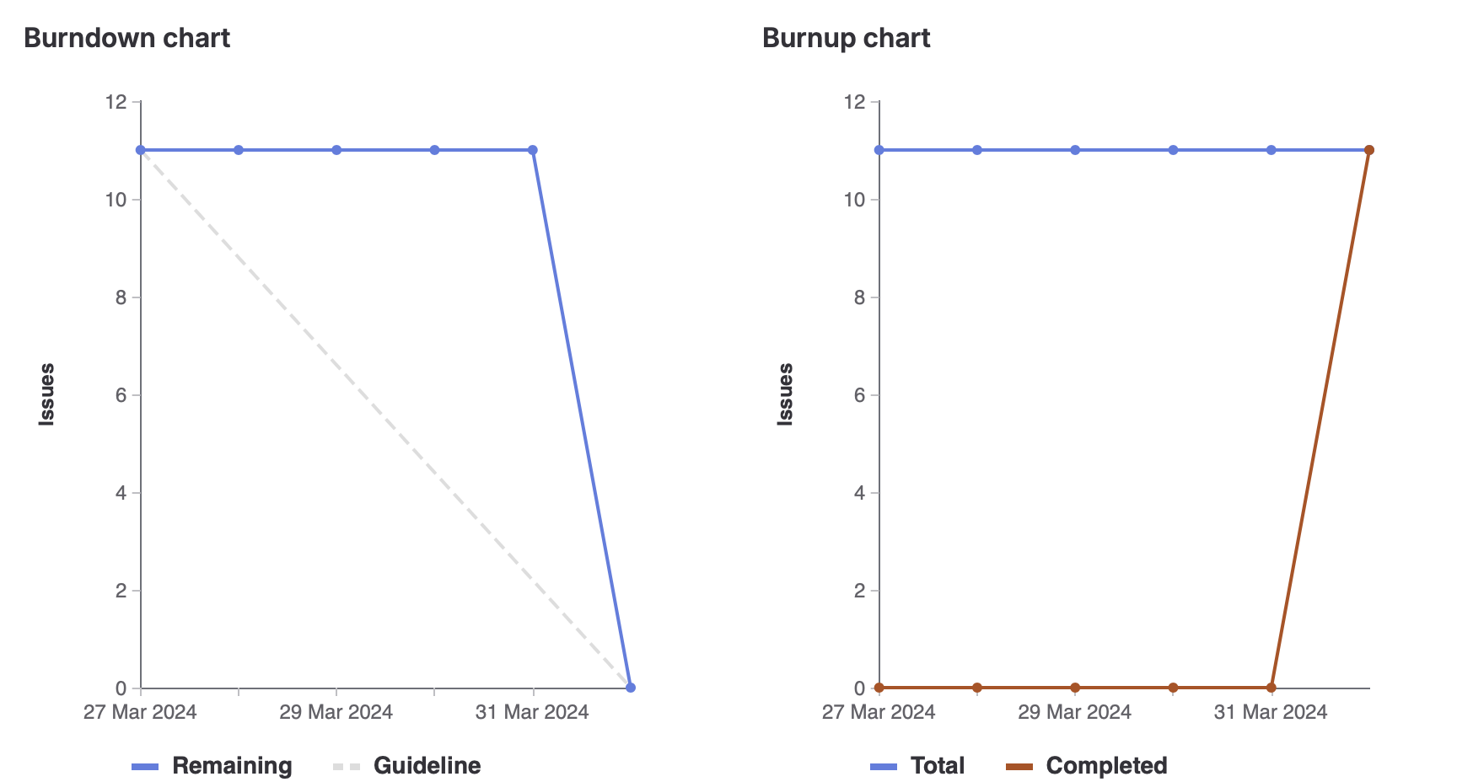
Burn Down

Slide 4
Kalindu
Jeopardy
About me
Maze Game
Total weight: 12
Jeopardy winning logic
About me page update
Maze game implementation + bug fixes

Slide 5
Eric
Maze Game
Bug fixes
Total weight: 12
Maze game implementation

Slide 6
Tehreem
Total weight: 12
Updated website graphics
01
New game and jeopardy + carousel graphics
Maze game bug fixing/implementation
02
Updated Personal Page
03
Updated my personal page to look nicer/go with the theme

Slide 7
Cavaari
Total weight: 12
Updated website graphics
01
Restyled Entry Page & Puzzle page to match theme
02
Maze game Design
Updated ReadME
03

Slide 8
KARINA
Total weight: 12
Updated website graphics
01
Restyled Maze page to match theme
02
Added links to carousel
Updated About me page
03

Slide 9
Egor
Total weight: 12
Updated About me page
01
Personal
02
General bug fixes

Slide 10
Muhammad
Total weight: 12
01
Maze game implementation
02
Mage bug fixes/ Game design
About me page Update
03

Slide 11
Reflection
What went well
Sprint planning
Implementation
Finishing website
What didn’t go well
Task completion timing
Task group meeting timing

Slide 12
Demo

